Slide 1

Android Lesson 4: Debugging Tools
By: Josh Chang
Notes:
Introduce yourself
Ask who has experience

Slide 2
Lesson’s Goal
Goal – Learn the tools available for when you code goes wrong
What we need:
Main Activity
Button to increment our click value
Learning Goals:
Error logs – How to read them
Toast – How to use the notificaiton object
Log – How to use Android’s logging feature
Debugger – How to run your code, line by line

Slide 3
Checking Your Error Logs

Slide 4
Create a New Project
Create a new project called: DebugPractice
API 16
Choose: Empty Activity
Leave the Activity and Layout name as default

Slide 5
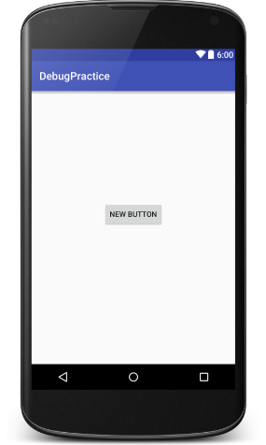
activity_main.xml
<?xml version="1.0" encoding="utf-8"?> <RelativeLayout xmlns:android="http://schemas.android.com/apk/res/android" xmlns:tools="http://schemas.android.com/tools" android:layout_width="match_parent" android:layout_height="match_parent" android:paddingBottom="@dimen/activity_vertical_margin" android:paddingLeft="@dimen/activity_horizontal_margin" android:paddingRight="@dimen/activity_horizontal_margin" android:paddingTop="@dimen/activity_vertical_margin" tools:context="net.joshchang.josh.debugpractice.MainActivity"> <Button android:layout_width="wrap_content" android:layout_height="wrap_content" android:text="New Button" android:onClick="incrementClick" android:id="@+id/button" android:layout_centerHorizontal="true" android:layout_marginTop="191dp" /> </RelativeLayout>

Slide 6
MainActivity.java
public class MainActivity extends AppCompatActivity { int clicks; Button button; @Override protected void onCreate(Bundle savedInstanceState) { super.onCreate(savedInstanceState); setContentView(R.layout.activity_main); // Error! Didn't initialize! button.setText("Click me!"); } public void incrementClick(View view) { clicks++; } }
Important: Make sure to copy exactly this!

Slide 7
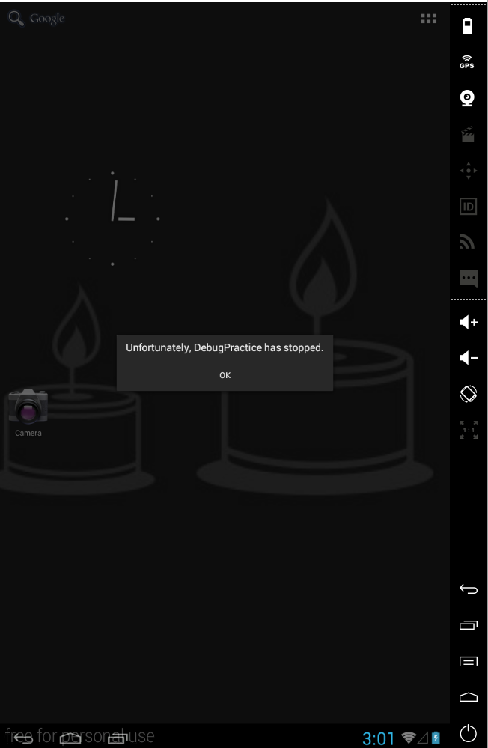
Error!
Run your app and see what happens:

Slide 8
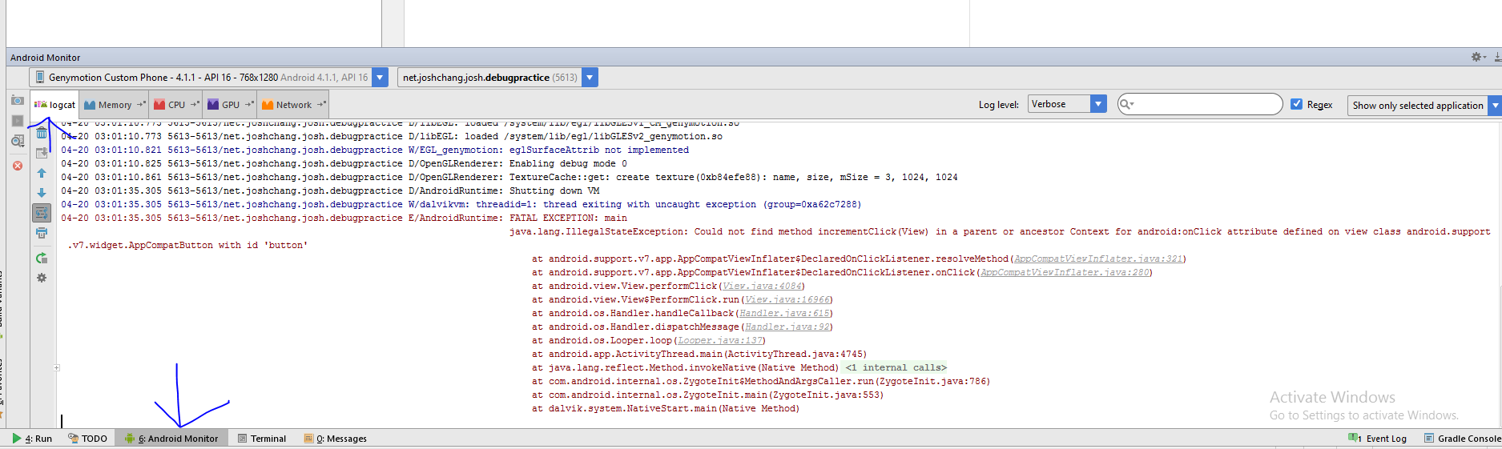
Error Log
Find error log under -> Android Monitor -> Logcat

Slide 9
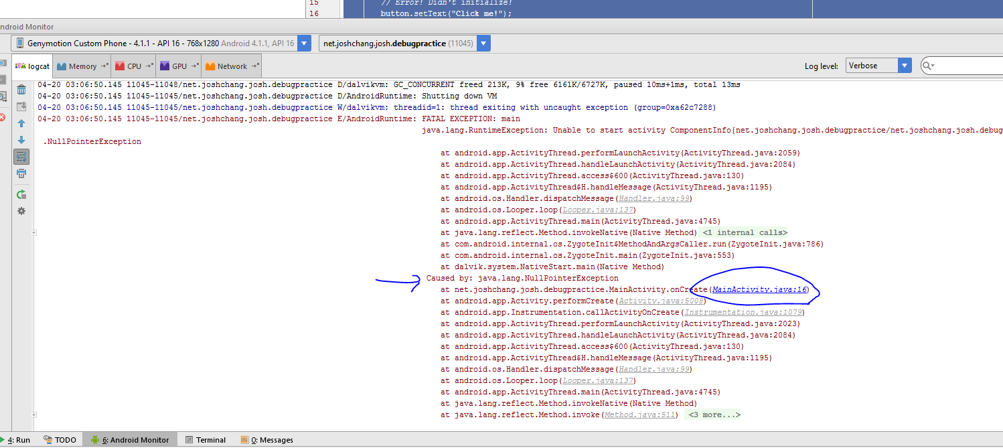
What’s the problem?
The problem is a: Java.lang.NullPointerException
Where? MainActivity.java at line 16
Tip: Only look at the errors where your files are mentioned to avoid confusion!

Slide 10
Go to line 16
To show line numbers:
File -> Settings -> Editor -> Appearance -> General -> Show Line Number

Slide 11
Problem and Solution
Problem:
We got a NullPointerException…
When we did… button.setText("Click me!");…
Solution:
We forgot to initialize our button!

Slide 12
Fix
public class MainActivity extends AppCompatActivity { int clicks; Button button; @Override protected void onCreate(Bundle savedInstanceState) { super.onCreate(savedInstanceState); setContentView(R.layout.activity_main); // Fix #1: initialize the code! button = (Button) findViewById(R.id.button); // Error #1! Didn't initialize! button.setText("Click me!"); } public void incrementClick(View view) { clicks++; } }

Slide 13
Testing with Toast

Slide 14
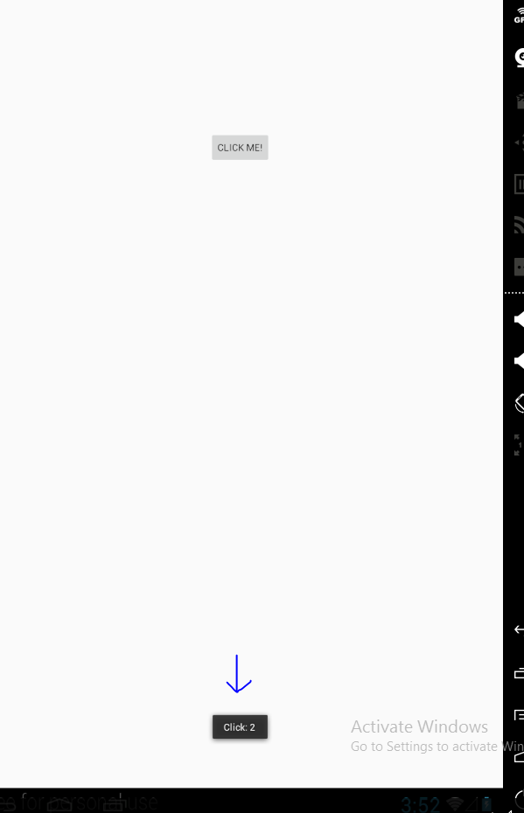
Toast
Toasts are the black notifications that appear at the bottom of your app!

Slide 15
How To Use Toast
Toast.makeText(this, “Your Message”, Toast.LENGTH_LONG).show();
Two options for length
Toast.LENGTH_LONG
Toast.LENGTH_SHORT

Slide 16
Next Goal
Goal: Initialize our click variable and every 5th time it gets hit we send a Toast

Slide 17
Using Toast!
public class MainActivity extends AppCompatActivity { int clicks; Button button; Toast toast; @Override protected void onCreate(Bundle savedInstanceState) { super.onCreate(savedInstanceState); setContentView(R.layout.activity_main); // Fix #1: initialize the code! button = (Button) findViewById(R.id.button); // Error #1! Didn't initialize! button.setText("Click me!"); // Error #2: wrong start value clicks = 1; } public void incrementClick(View view) { clicks++; // Whenever we hit our button 5 times, we would show a toast notification if (clicks % 5 == 0) { Toast.makeText(this, "You've clicked your button 5 times!", Toast.LENGTH_SHORT).show(); } } }

Slide 18
Problem!
We only have to hit the button 4 times for the toast to show up!
Easy to fix, but how would we debug this if it was more complicated problem?
Solution 1 – Use Toast to output our click values
Solution 2 – Or…

Slide 19
Using Log.d

Slide 20
What is Log.d
Android’s logging debugger class
Prints value to our Catlog console in Android Studio
How to use:
Log.d(“Log Tag", “Log Message");

Slide 21
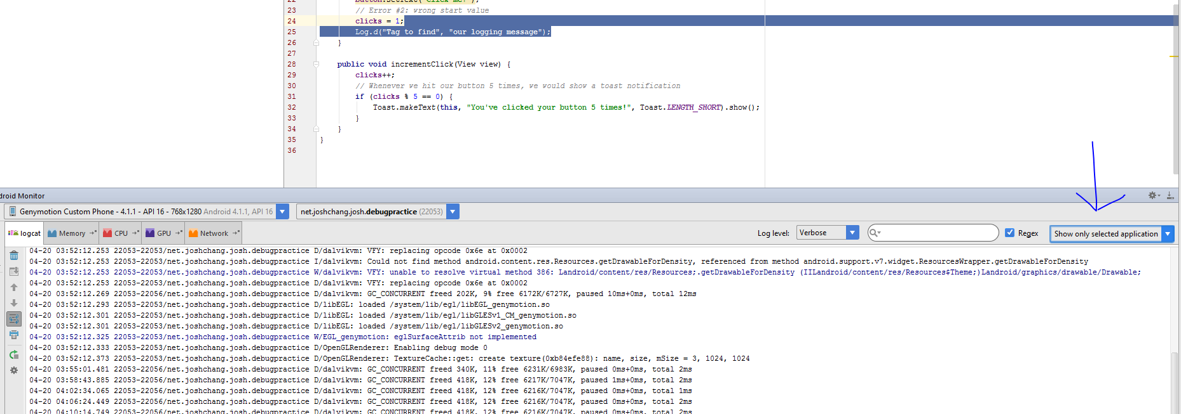
Using Tags
In the top right corner of console
Select Edit Filter Configuration
Set Log Tag to the name of our tag that we set

Slide 22
MainActivity.java
public class MainActivity extends AppCompatActivity { int clicks; Button button; Toast toast; @Override protected void onCreate(Bundle savedInstanceState) { super.onCreate(savedInstanceState); setContentView(R.layout.activity_main); // Fix #1: initialize the code! button = (Button) findViewById(R.id.button); // Error #1! Didn't initialize! button.setText("Click me!"); // Error #2: wrong start value clicks = 1; Log.d("Tag to find", "our logging message"); } public void incrementClick(View view) { clicks++; Log.d("DebugPractice", "our click is " + clicks); // Whenever we hit our button 5 times, we would show a toast notification if (clicks % 5 == 0) { Toast.makeText(this, "You've clicked your button 5 times!", Toast.LENGTH_SHORT).show(); } } }
We added a Log object in our incrementClick to see what our value is and what do you know! We set our starting value to 1 instead of 0! Oops!

Slide 23
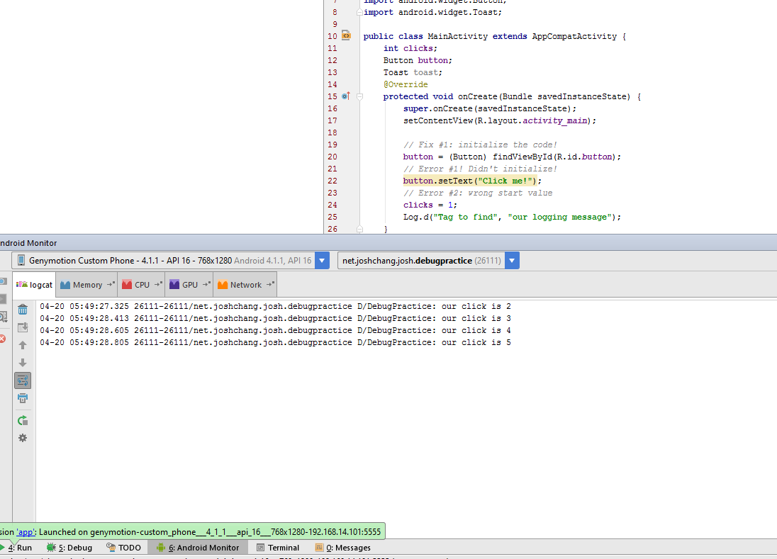
Log Results
Run your code and see your logs!

Slide 24
Using the Debugger

Slide 25
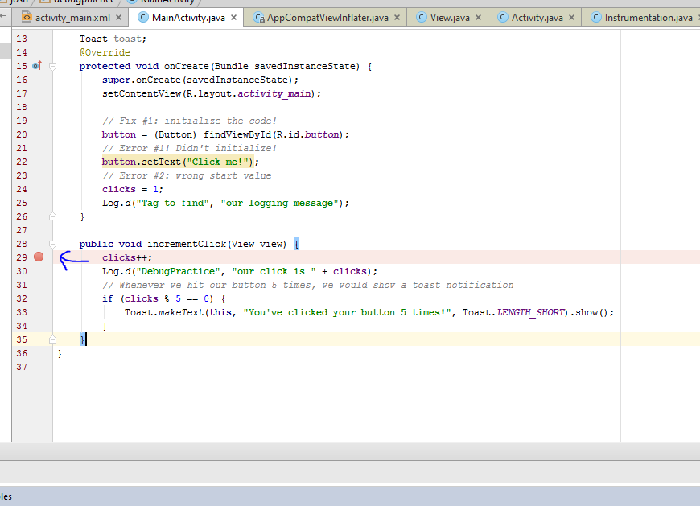
Debugger and You
With the debugger you can walk through your code line by line and see the values of your variables
You can stop at specific locations in your code by setting break points

Slide 26
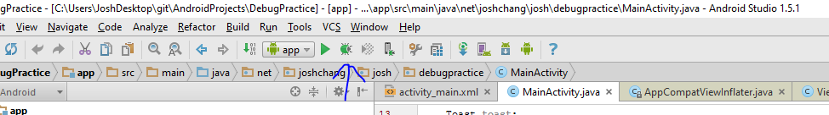
Running Debug Mode

Slide 27
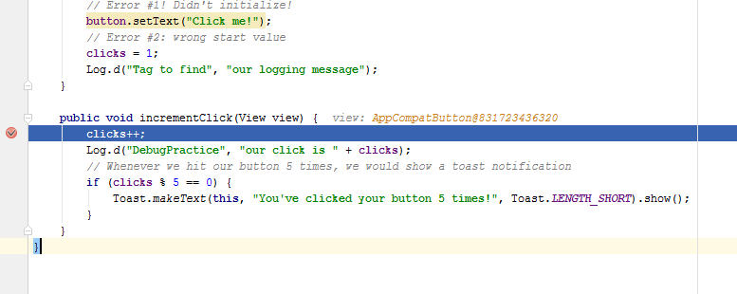
Run Your App Like Normal Until…
You hit the breakpoint

Slide 28
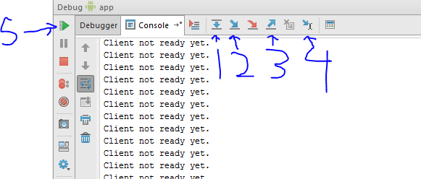
Controls
1. Step Over: Moves to the next line
2. Step In: Moves into a method or the next line
3. Step Out: Moves out of your current method
4. Run to Cursor: Moves to the line your code is selected
5. Resume Program: Continues your program, good to hit another breakpoint.

Slide 29
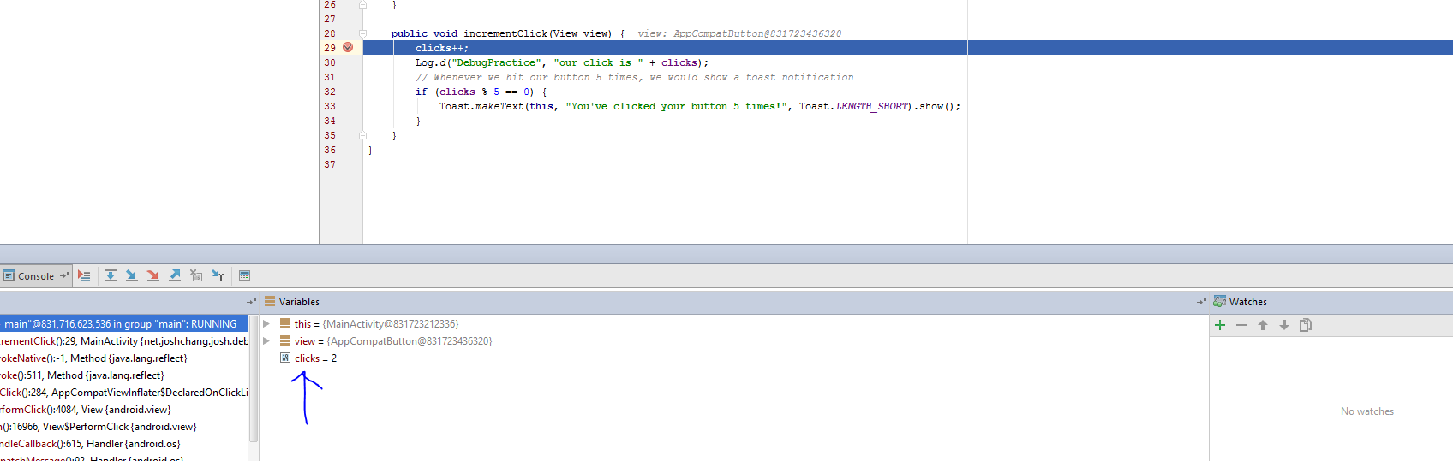
Get Variable Information
Get information on the variables in your current line

Slide 30
Happy Debugging!

